Slide 1

SRI INDU COLLEGE OF ENGINEERING AND TECHNOLOGY DEPARTMENT OF AIML
III BTECH I SEM
BATCH : 9
SUBJECT: Skill Development Course Laboratory
TOPIC: Geo-Tracker App
TEAM MEMBERS:
S.Sirisha | 23D41A66G9
T.Harini | 23D41A66H0
T.Rishwanth | 23D41A66H1
U.Navya | 23D41A66H2
U.Akash | 23D41A66H3
batch 9

Slide 2
ABSTRACT
The Geo-Tracker app is a Flutter-based mobile application designed to fetch real-time GPS coordinates and convert them into human-readable addresses such as city, state, and country. Unlike complex commercial apps, this system focuses on simplicity, transparency, and ease of understanding, making it ideal for academic and learning purposes. Users can see how GPS coordinates are obtained, how permissions are handled, and how raw data is converted into meaningful location information. This lightweight app provides a practical introduction to location-based services and mobile app development without relying on heavy maps, complex APIs, or internet connectivity.
batch 9

Slide 3
EXISTING SYSTEM
Popular apps like Google Maps, Uber, Swiggy, and Zomato use built-in GPS for navigation and location services.
Feature-rich systems with live maps, routing algorithms, traffic prediction, background tracking, and server-side APIs.
Resource-intensive and often require continuous internet connectivity.
Hide low-level processes like how GPS coordinates are retrieved and converted to addresses.
Not suitable for educational purposes due to complexity and lack of transparency.
batch 9

Slide 4
PROPOSED SYSTEM
A lightweight Flutter app designed for educational and small-scale use.
Fetches real-time GPS coordinates and converts them to human-readable addresses (city, state, country).
Handles permissions and error checking effectively.
Works offline for basic location fetching.
Minimal UI for clarity and simplicity.
Customizable for learning purposes: experiment with coordinate formats, UI, and permission prompts.
Provides a transparent and hands-on approach to understanding location-based app development.
batch 9

Slide 5
HARDWARE AND SOFTWARE REQUIREMENTS
HARDWARE REQUIREMENTS:
Processor :- Intel Core i5 / Mac M-series chip
Hard Disk :- 256 GB
RAM :- 8GB(Minimum)
SOFTWARE REQUIREMENTS:
Operating System :- Windows /MAC OS
Programming Language :- Dart
Software,IDE used :- Flutter,Android Studio
batch 9

Slide 6
IMPLEMENTATION
App Launch:
The user opens the app and sees a simple screen with a button to get location.
Button Press:
When the user taps “Get Location”, the app starts fetching location.
Check Location Services & Permissions:
The app checks if GPS is enabled.
Requests permission from the user if not already granted.
Get Current Coordinates:
Using GPS, the app fetches the latitude and longitude of the device.
Convert to Address:
The app converts latitude and longitude into a readable address (city, state, country).
Display Location:
The location details are displayed on the screen.
batch 9

Slide 7
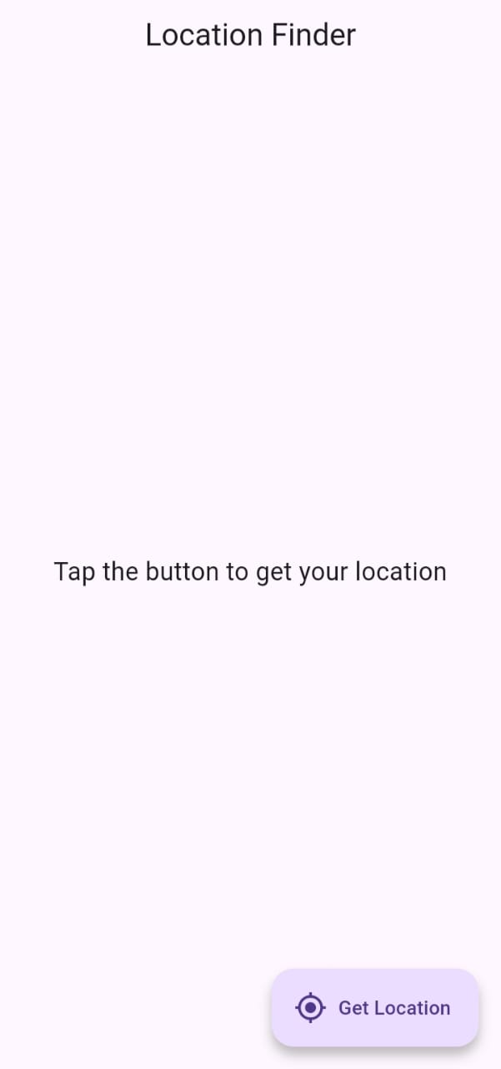
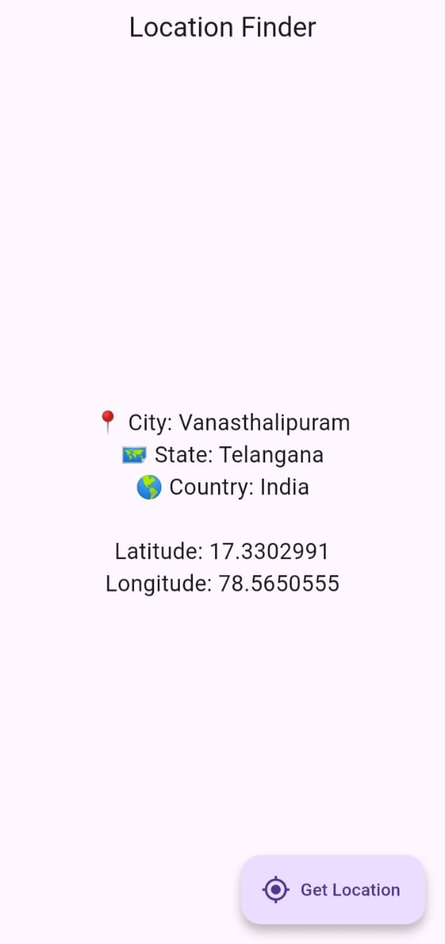
OUTPUT
batch 9

Slide 8
CONCLUSION
The Geo-Tracker app successfully demonstrates the essential principles of location-based services in a simple and educational manner. It allows users to fetch GPS coordinates, convert them into human-readable addresses, and handle permissions and errors effectively. Compared to commercial apps, it is lightweight, transparent, and highly customizable, making it ideal for learning and experimentation. By bridging the gap between theory and practical implementation, the app provides students and developers with hands-on experience in Flutter and GPS integration, laying the foundation for more advanced location-based applications in the future.
batch 9

